Slide 1
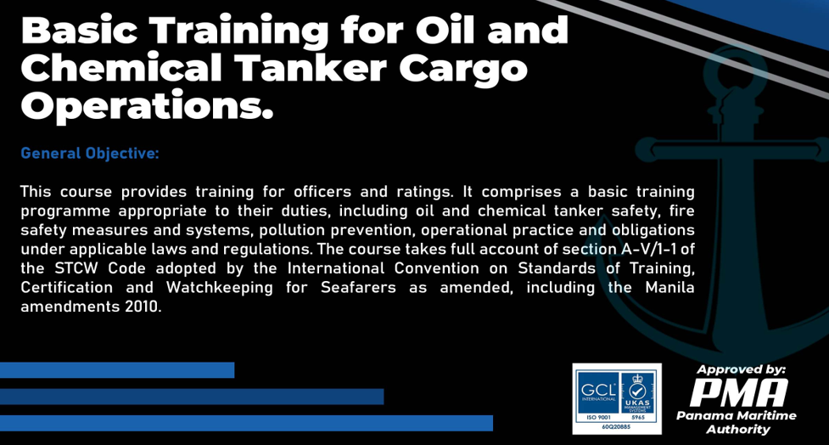

Slide 2
Oil Ships
An oil tanker, also known as a petroleum tanker, is a ship designed for the bulk transport of oil or its products. There are two basic types of oil tankers: crude tankers and product tankers. Crude tankers move large quantities of unrefined crude oil from its point of extraction to refineries. Product tankers, generally much smaller, are designed to move refined products from refineries to points near consuming markets.

Slide 3
Types of Oil Tankers
Tankers however are not just restricted to one particular type or variety. There are many varied types of tankers that are used in the process of oceanic cargo transportation. This classification of tankers can be based on several factors. However, there are two categories in which shipping tankers can be classified:
a. By Type/Purpose.
b. By Size.

Slide 4
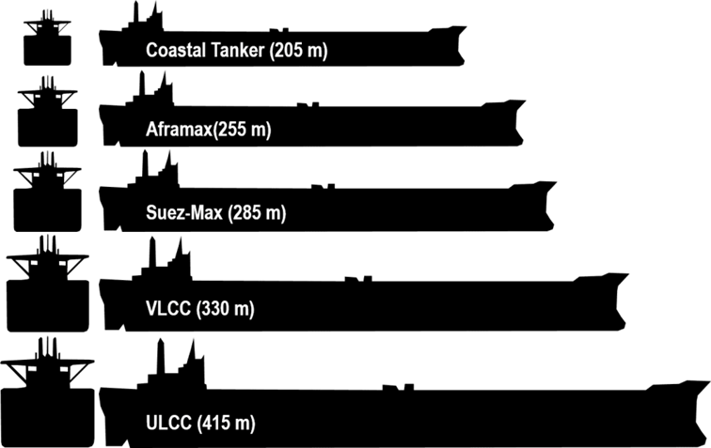

Slide 5
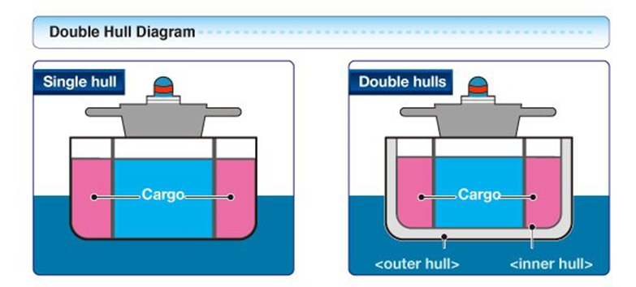

Slide 6
Types of Chemical Tankers
A chemical tanker is a type of tanker ship designed to transport chemicals in bulk. As defined in MARPOL Annex II, chemical tanker means a ship constructed or adapted for carrying in bulk any liquid product listed in chapter 17 of the International Bulk Chemical Code. As well as industrial chemicals and clean petroleum products, such ships also often carry other types of sensitive cargo which require a high standard of tank cleaning, such as palm oil, vegetable oils, tallow, caustic soda, and methanol.

Slide 7
Classification
In general, ships carrying chemicals in bulk are classed into three types:
a. Type 1: is a chemical tanker intended to transport Chapter 17 of the IBC Code products with very severe environmental and safety hazards which require maximum preventive measures to preclude an escape of such cargo.
b. Type 2: is a chemical tanker intended to transport Chapter 17 of the IBC Code products with appreciably severe environmental and safety hazards which require significant preventive measures to preclude an escape such as cargo.
c. Type 3: is a chemical tanker intended to transport Chapter 17 of the IBC Code products with sufficiently severe environmental and safety hazards which require a moderate degree of containment to increase survival capability in a damaged condition. Most chemical tankers are IMO 2 and 3 rated, since the volume of IMO 1 cargoes is very limited.

Slide 8
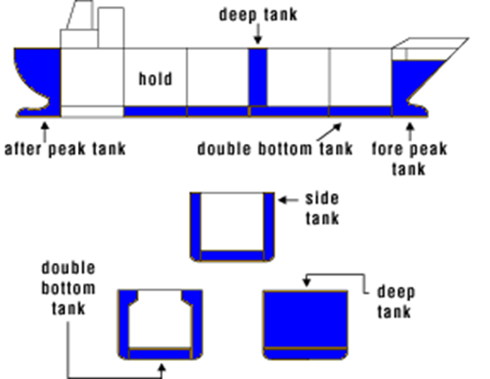
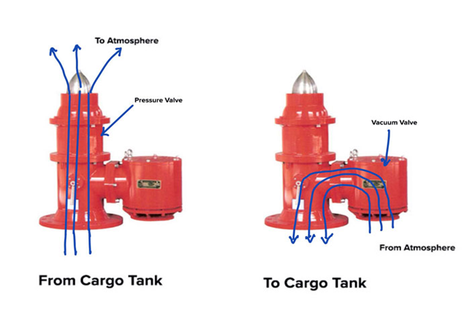

Slide 9
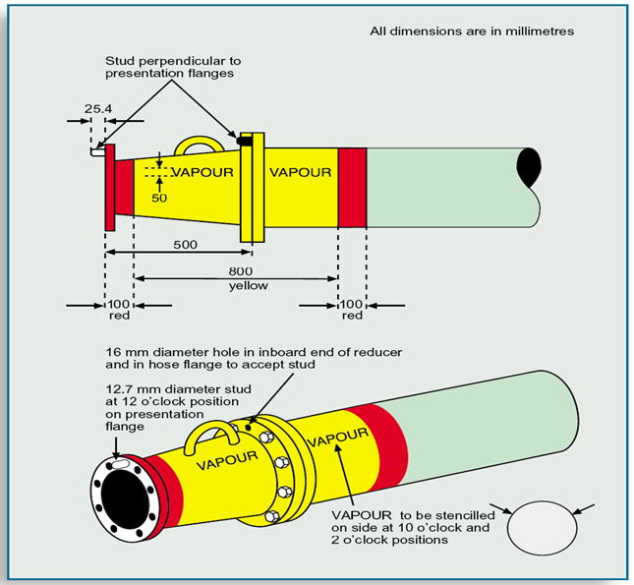
Vapour manifold presentation flanges, orientation and labelling

Slide 10
Types of Pumps
Centrifugal Pumps
Positive Displacement Pump
Submerged Pumps
Portable Submersible (Emergency) Pump
Screw Pumps
Piston Pump
Lift pump
Force pump

Slide 11
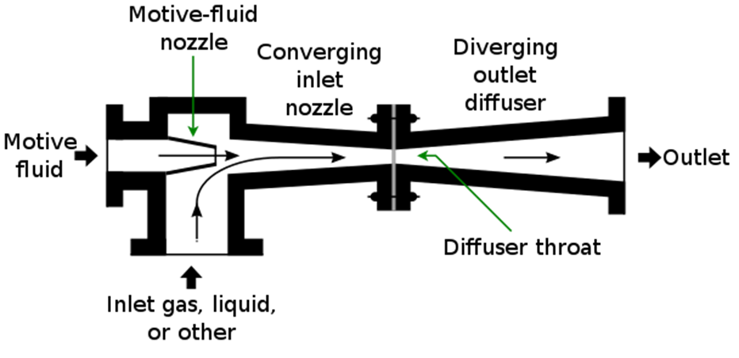
Use of eductors

Slide 12
Health hazards
Skin Contact
Ingestion
Petroleum gases
Exposure Limits
Effects
Oxygen Deficiency
Confined Spaces

Slide 13
Signs and Symptoms of Asphyxia
Any of the following symptoms can lead to asphyxia.
Difficulty and/ or noisy breathing, which may ultimately lead to cessation
Rapid pulse
High blood pressure (hypertension)
Cyanosis of the face
Swollen veins on the head and neck
Convulsions
Paralysis
Slowly losing consciousness

